Slide 1


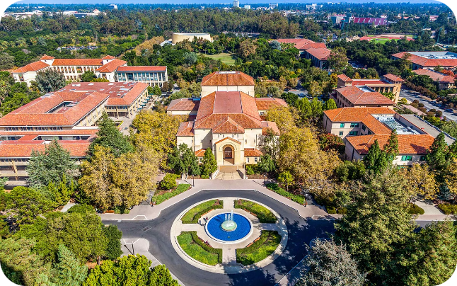
University Department Information System
This presentation outlines the key functionalities of the University Department Information System (UDIS), designed to streamline operations, enhance data management, and improve communication within the Department. UDIS caters to the needs of various user types, including administrators, faculty, students, and non-teaching staff, providing a comprehensive platform for academic, administrative, and financial tasks. The system aims to provide a user-friendly interface for efficient data entry, retrieval, and analysis, ensuring seamless communication and collaboration amongst all stakeholders.

Slide 2


Admin User
1
User Management
The Admin user is responsible for creating and managing all user accounts within the system. This includes adding, modifying, and deleting user profiles, assigning roles and permissions to ensure appropriate access levels. The Admin also has the authority to reset passwords for users who have forgotten them.
2
Department Information
The Admin user manages crucial department information such as the department name, address, contact details, and staff details. They can update these details as needed to reflect any changes within the Department.
3
System Configuration
The Admin user has the ability to customize the system settings according to the Department's specific needs. This includes setting academic calendars, course structures, and defining the structure and fields for various data forms.
4
Reporting
The Admin user can generate reports on various aspects of the system, including student enrollment, course registration, faculty workload, and financial transactions. These reports provide valuable insights for informed decision-making within the Department.

Slide 3
Student User
Registration
Grades and Academic Progress
Communication and Support
Students can access and view their personal information such as their name, address, contact details, and academic history. They can update their personal information as needed.
Students can view and respond to announcements made by the department or faculty members.
Students can access their academic transcripts, view their grades for each course, and calculate their grade point average (GPA) for each semester and their overall CGPA.
The system provides a forum for students to ask questions and get support from faculty members or the department staff.
Students can browse available courses, view course descriptions and syllabuses, and register for courses each semester. The system displays their previous courses, current courses, and any backlogs.
The system allows students to track their academic progress, monitor their course registration status, and view their graduation requirements.
Students can access important department resources such as contact information, policies, and student handbooks.
Students can submit assignments, download course materials, and participate in online discussions within the system.
The system allows students to pay tuition fees online through secure payment gateways, view payment history, and download receipts.

Slide 4






Faculty User
Course Management
Faculty members can manage their course details, including course syllabuses, schedules, and assignment deadlines. They can upload course materials and grade assignments online.
Student Evaluation
Faculty members can submit student grades for each course. The system automatically calculates student GPAs and ensures accuracy.
Research & Publication
Faculty members can document their research projects, publications, and other scholarly activities. This information can be accessed by other faculty members and researchers.
Communication
Faculty members can communicate with students, send announcements, and respond to student inquiries. The system provides a platform for online discussions and Q&A sessions.

Slide 5


Head of Department (HOD)
User Management
The HOD can view and manage faculty member profiles, including their teaching assignments, research activities, and other relevant details.
Department Finances
The HOD has access to view and manage the Department's financial records, including budget allocation, expenditure reports, and income sources. They can approve and monitor expenses.
Academic Oversight
The HOD can monitor student enrollment, course registration, and academic performance. They can review and approve course offerings and curriculum updates.
Research and Development
The HOD can review and approve research proposals submitted by faculty members, monitor research project progress, and promote research activities within the department.

Slide 6
Department Secretary
Student Registration
1
The Department Secretary is responsible for entering and updating student registration data, including course selections, academic history, and any backlogs.
2
Grade Entry
The Department Secretary enters grades submitted by instructors into the system, ensuring accuracy and completeness. They also manage the generation of official grade sheets for students.
Inventory Management
3
The Department Secretary is responsible for maintaining an inventory of department resources, including equipment, furniture, and supplies. They can track asset locations and manage inventory requests.
4
Financial Transactions
The Department Secretary records financial transactions, including departmental grants, income from consultancy services, and expenses. They maintain financial records and generate financial reports.
Research and Publication Tracking
5
The Department Secretary is responsible for recording and updating details about research projects and publications by faculty members.

Slide 7


Non-Teaching Staff
Equipment Management
Non-teaching staff, such as lab technicians, may be responsible for managing and maintaining department equipment. They can track equipment usage, schedule maintenance, and report any issues.
Library Support
Library staff can use the system to manage library resources, including book acquisitions, circulation records, and overdue notices. They can also track student borrowing history.
Administrative Support
Non-teaching staff can provide administrative support to the department, such as handling student inquiries, scheduling appointments, and managing departmental events.

Slide 8


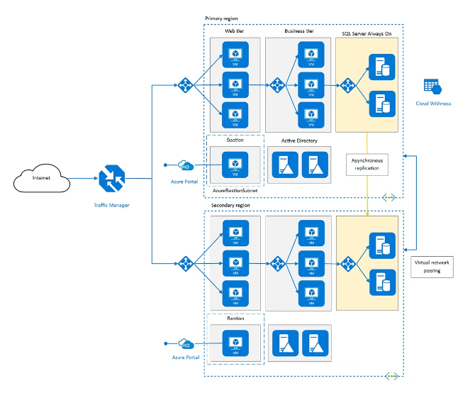



System Features
Querying
The system allows users to perform various queries to retrieve specific information. For example, students can view their own grades and transcripts, faculty members can retrieve student records for their courses, and administrators can generate reports on student enrollment.
Security
The system implements robust security measures to protect sensitive data and ensure user privacy. This includes user authentication, role-based access control, and data encryption.
Notifications
The system provides various notification mechanisms to keep users informed about important events and updates. Users can receive email alerts, in-app notifications, or text messages depending on their preferences.
Reporting
The system generates various reports for different user types, including academic progress reports, financial reports, and inventory reports. These reports provide valuable insights for decision-making and monitoring progress.

Slide 9


Benefits of UDIS
1
Enhanced Efficiency
UDIS automates many manual processes, streamlining workflows and reducing administrative burden. It eliminates the need for paper-based records and allows for quicker access to information.
2
Improved Communication
The system provides a platform for effective communication amongst all stakeholders, including students, faculty, staff, and administrators. Users can access important announcements, receive timely notifications, and communicate directly with each other.
3
Data Accuracy and Integrity
UDIS ensures data accuracy and consistency through its integrated data management features. The system enforces data validation rules and provides audit trails for tracking changes.
4
Decision Support
The system provides valuable data analytics capabilities, allowing users to generate reports and gain insights into various aspects of department operations. These insights support informed decision-making and strategic planning.

